Slide 1
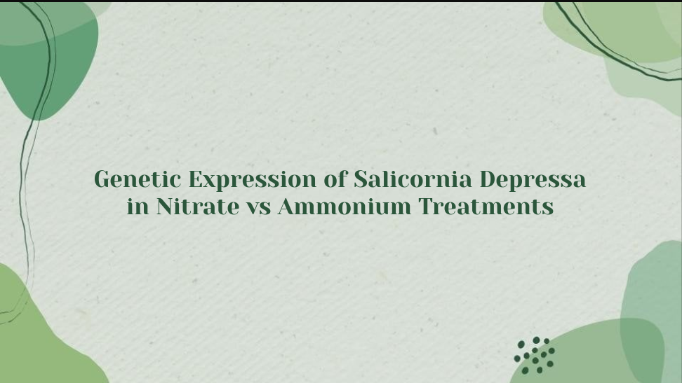
Matheus Berbet

Slide 2
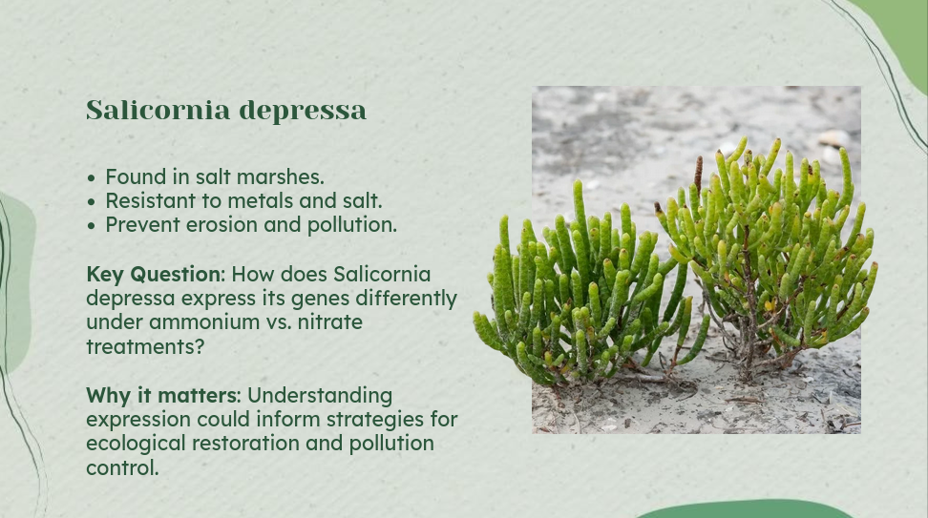

Slide 3

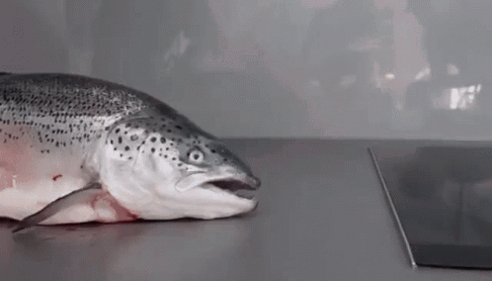
Transcriptome.fa
Index.fa
Metadata.xlsx
InterleavedRNA.fastq
runner.sh
Analysis R script *
Analysis Pipeline
quant.sf

Slide 4
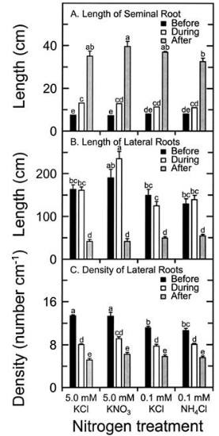
Key Results
Results from my analysis are pending.
“Root growth as a function of ammonium and nitrate in the root zone” paper found Potassium Nitrate (KNO) showed most growth.

Slide 5
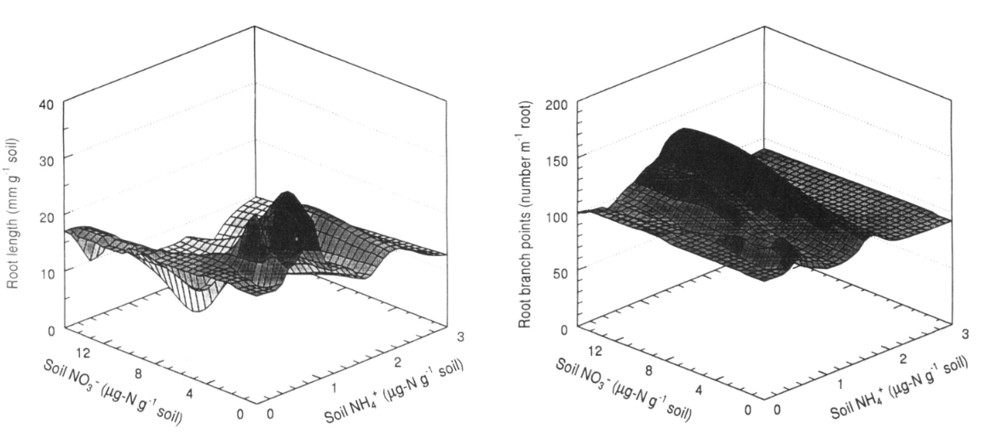
Key Results
“Saltmarsh plant responses to eutrophication” paper demonstrated that with tidal delivery, realistic water column concentrations of nitrate may not achieve N-loading rates high enough to elicit ecologically significant responses on the high marsh

Slide 6
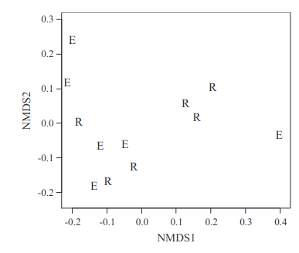
Key Results
“Root growth as a function of ammonium and nitrate in the root zone” paper found Potassium Nitrate (KNO) showed most growth.

Slide 7

Conclusions / Lessons Learned
Salicornia depressa adapts gene expression based on nitrogen type, aiding resilience in varied environments.

Slide 8
Bibliography
BLOOM, A.J., JACKSON, L.E. and SMART, D.R. (1993), Root growth as a function of ammonium and nitrate in the root zone. Plant, Cell & Environment, 16: 199-206. ttps://doi.org/10.1111/j.1365-3040.1993.tb00861.x
Johnson, D.S., Warren, R.S., Deegan, L.A. and Mozdzer, T.J. (2016), Saltmarsh plant responses to eutrophication. Ecol Appl, 26: 2649-2661. https://doi.org/10.1002/eap.1402
Bloom, A.J., Meyerhoff, P.A., Taylor, A.R. et al. Root Development and Absorption of Ammonium and Nitrate from the Rhizosphere. J Plant Growth Regul 21, 416–431 (2002). https://doi.org/10.1007/s00344-003-0009-8

Slide 9


